Slide 1
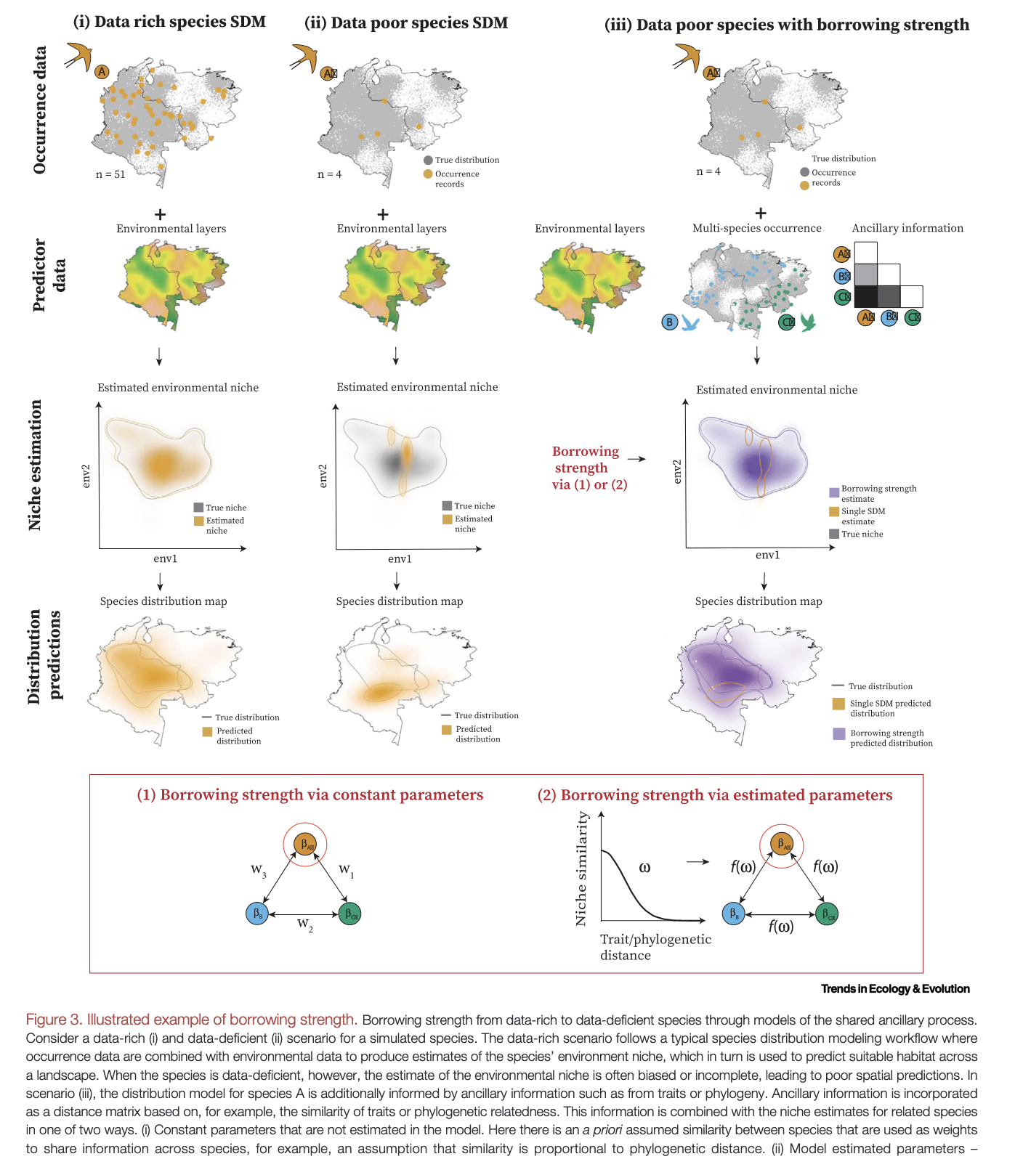
Shubhi Sharma, Kevin Winner, Laura J. Pollock, James T. Thorson, Jussi Mäkinen, Cory Merow, Eric J. Pedersen, Kalkidan F. Chefira, Julia M. Portmann, Fabiola Iannarilli, Sara Beery, Riccardo De Lutio, Walter Jetz, 2025. No species left behind: borrowing strength to map data-deficient species. Trends in Ecology & Evolution 40, 699–711. https://doi.org/10.1016/j.tree.2025.04.010
Class focus area: Phylogenies to help with data deficiency
EEB603: Brian O’Meara
All quotes and images from the above paper unless otherwise noted

Slide 2
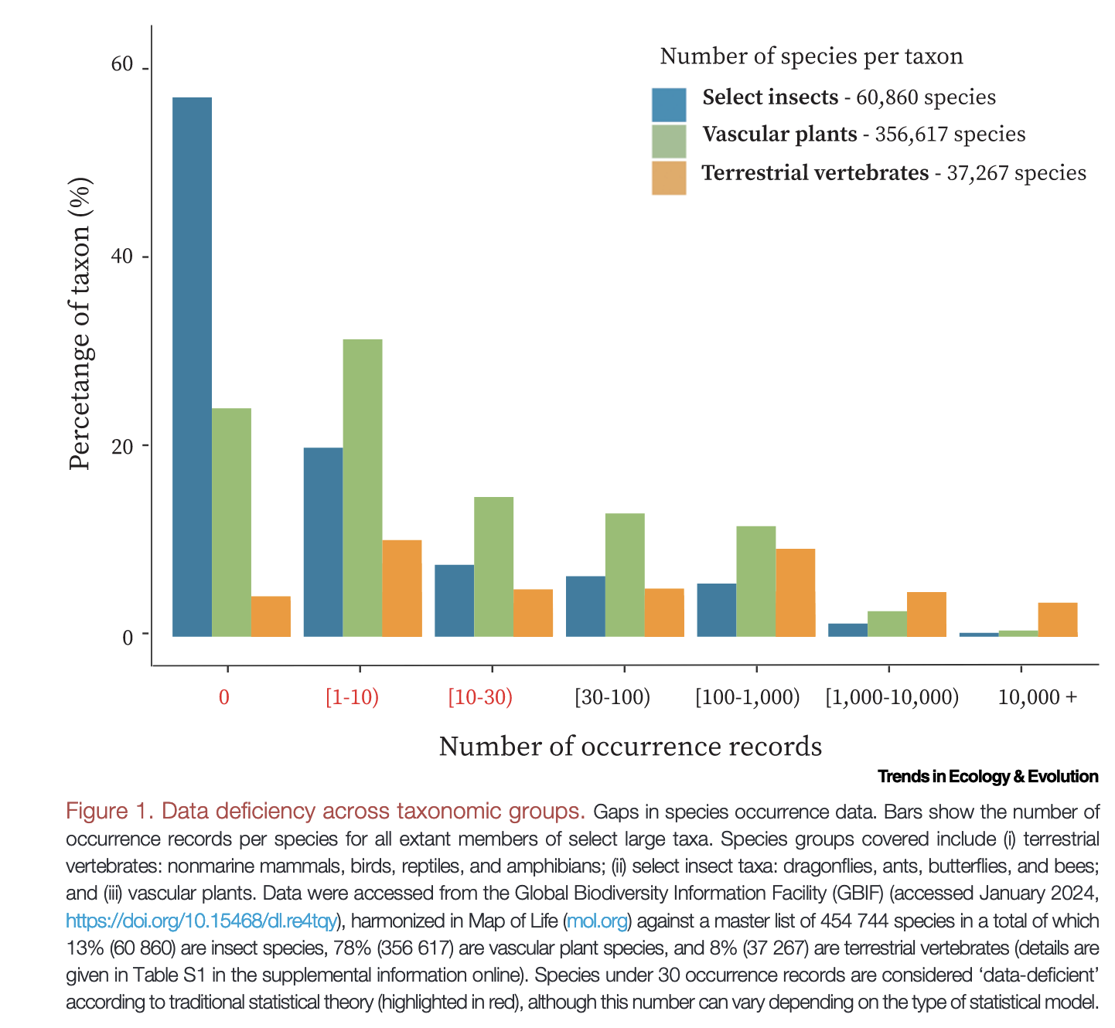

Slide 3
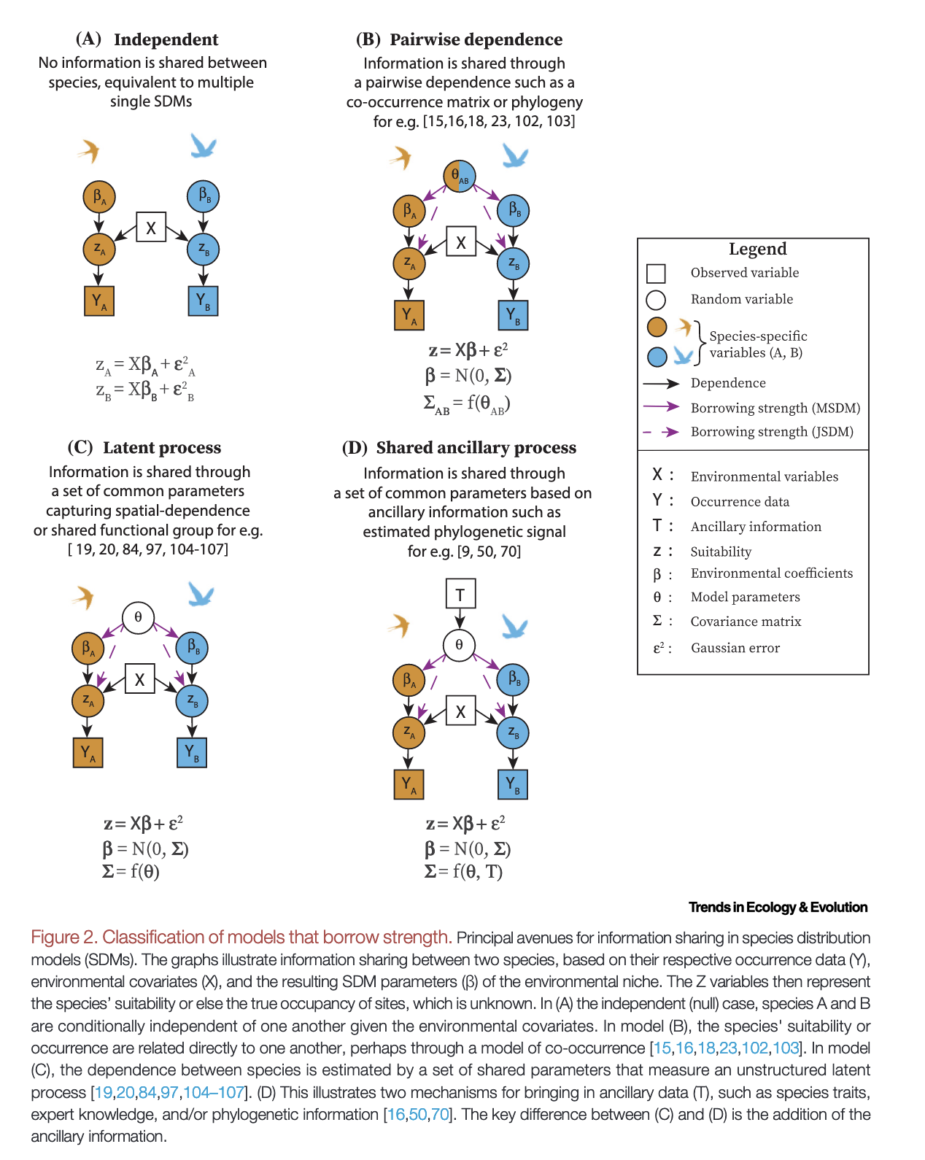

Slide 4
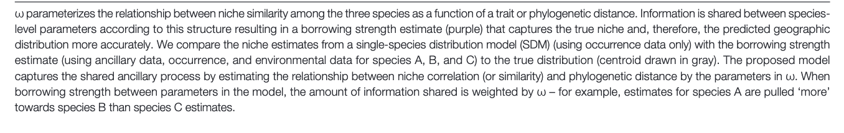

Slide 5
“The existing methods utilize the phylogenetic distance matrix to model the covariance between species-level environment coefficients, implicitly assuming that similarity in species–environment relationships is proportional to phylogenetic distance (Figure 3). This is a pattern expected only under the neutral expectation of niche evolution, described by a Brownian motion (BM) model, whereas there is mounting evidence that other patterns, such as niche conservatism (more similar than expected under BM) are common [59,68,69]”

Slide 6
“The existing methods utilize the phylogenetic distance matrix to model the covariance between species-level environment coefficients, implicitly assuming that similarity in species–environment relationships is proportional to phylogenetic distance (Figure 3). This is a pattern expected only under the neutral expectation of niche evolution, described by a Brownian motion (BM) model, whereas there is mounting evidence that other patterns, such as niche conservatism (more similar than expected under BM) are common [59,68,69]”
False
True

Slide 7
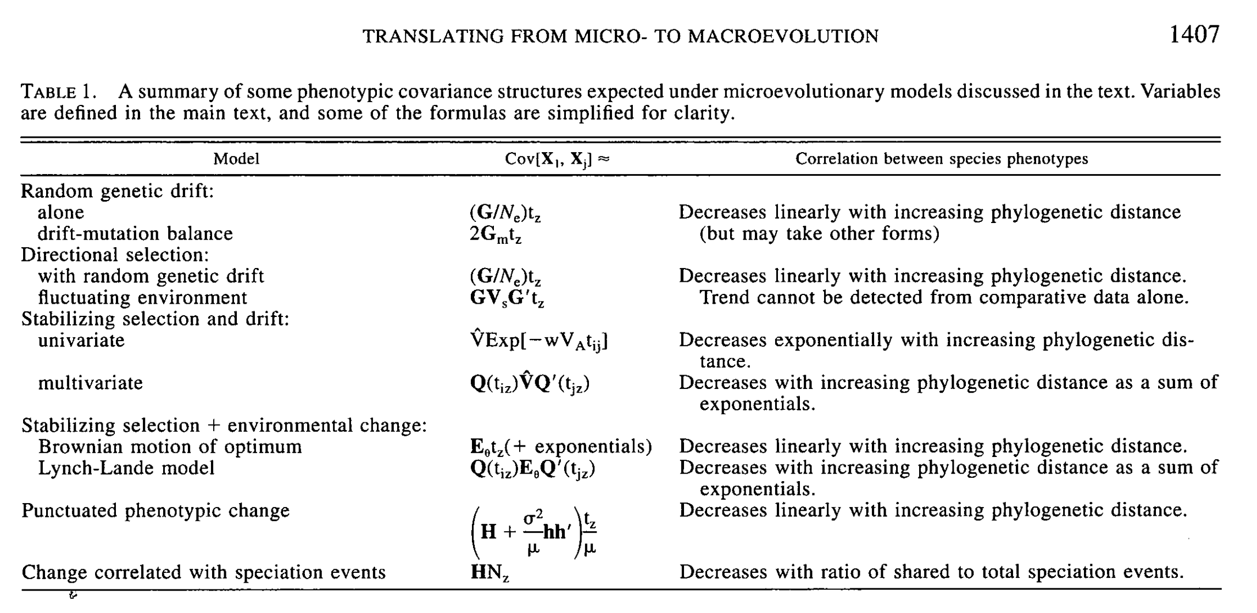
“The existing methods utilize the phylogenetic distance matrix to model the covariance between species-level environment coefficients, implicitly assuming that similarity in species–environment relationships is proportional to phylogenetic distance (Figure 3). This is a pattern expected only under the neutral expectation of niche evolution, described by a Brownian motion (BM) model, whereas there is mounting evidence that other patterns, such as niche conservatism (more similar than expected under BM) are common [59,68,69]”
False
True
Brownian →
Brownian →
Brownian →
Brownian →
Brownian →
Brownian →
Hansen and Martins 1996 Evolution https://doi.org/10.1111/j.1558-5646.1996.tb03914.x

Slide 8
What are SDMs for?
Independent vs Multispecies vs Joint-species models?
Should we decide on the correlation (constant parameters) or let the data drive it (estimated parameters)?
What is machine learning? Is it like ChatGPT?
In borrowing strength, are we also borrowing weakness?
What about issues from allopatric speciation? Competition?
What is the point where you say, “there aren’t enough data to answer this question”?
“Wallacean shortfall” [also see “Linnaean shortfall”]
What ancillary data should we use?
Should we do this beyond SDMs – what other traits are missing data that we care about?

