Slide 1
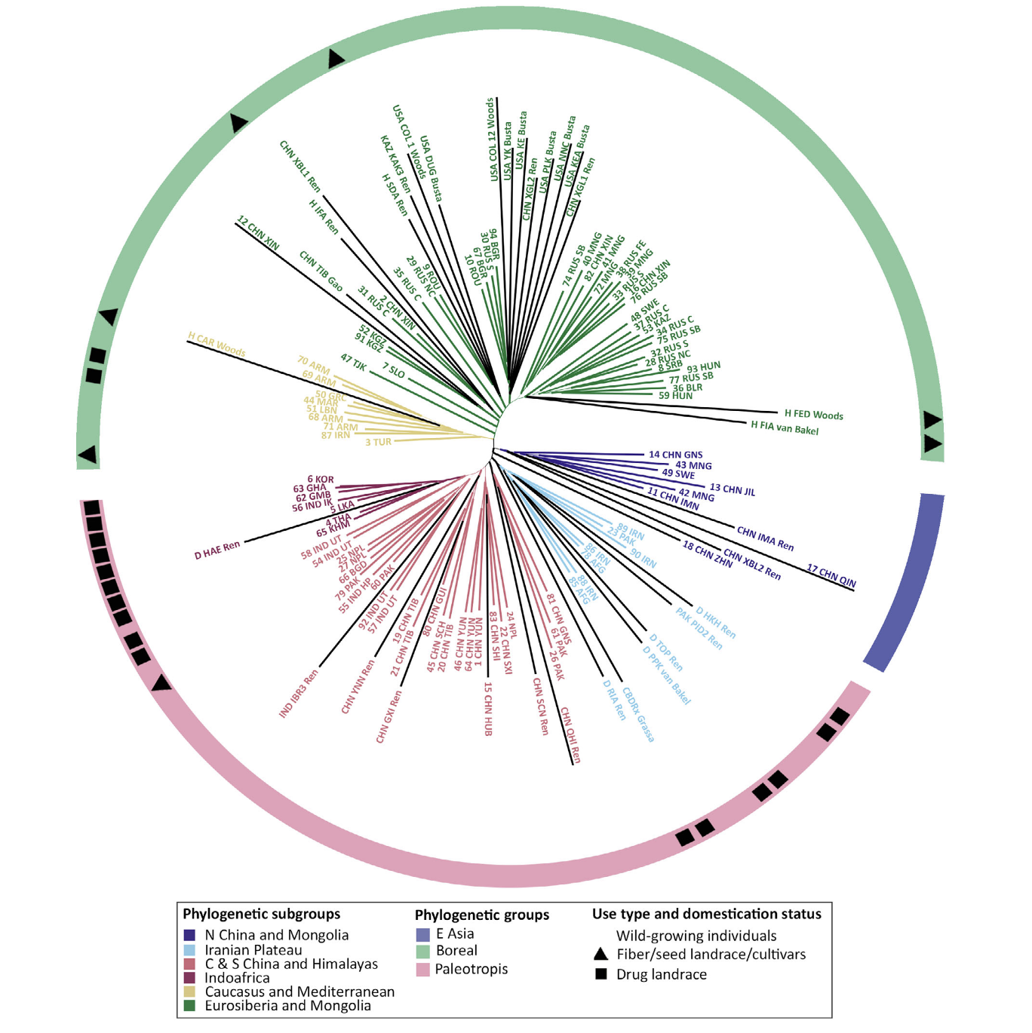
Manica Balant*, Daniel Vitales*, Zhiqiang Wang*, Zoltán Barina, Lin Fu, Tiangang Gao, Teresa Garnatje, Airy Gras, Muhammad Qasim Hayat, Marine Oganesian, Jaume Pellicer, Seyed A. Salami, Alexey P. Seregin, Nina Stepanyan-Gandilyan, Nusrat Sultana, Shagdar Tsooj, Magsar Urgamal, Joan Vallès, Robin van Velzen, Lisa Pokorny. 2025. “Integrating target capture with whole genome sequencing of recent and natural history collections to explain the phylogeography of wild-growing and cultivated Cannabis”. Plants People Planet. 1-18. https://doi.org/10.1002/ppp3.70043 [* = equal contributions]
Class focus area: Phylogeography
EEB603: Brian O’Meara
All quotes and images from the above paper unless otherwise noted

Slide 2
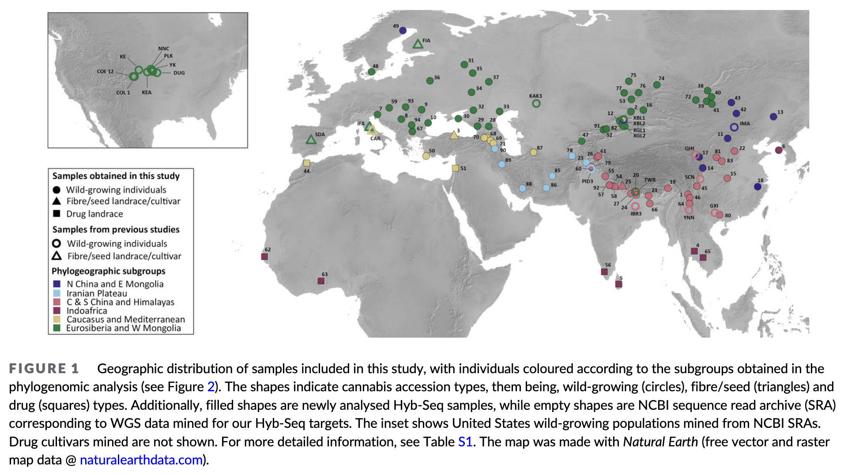

Slide 3
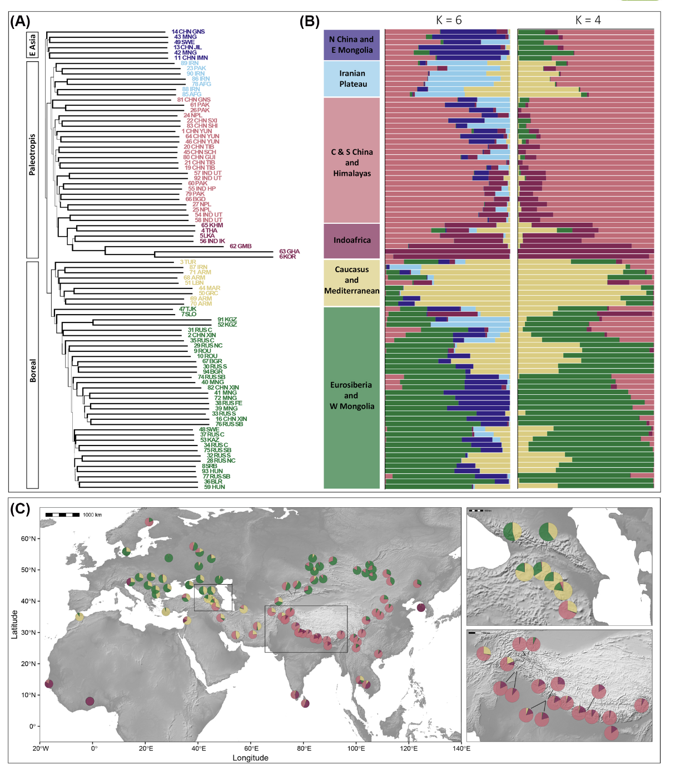

Slide 5
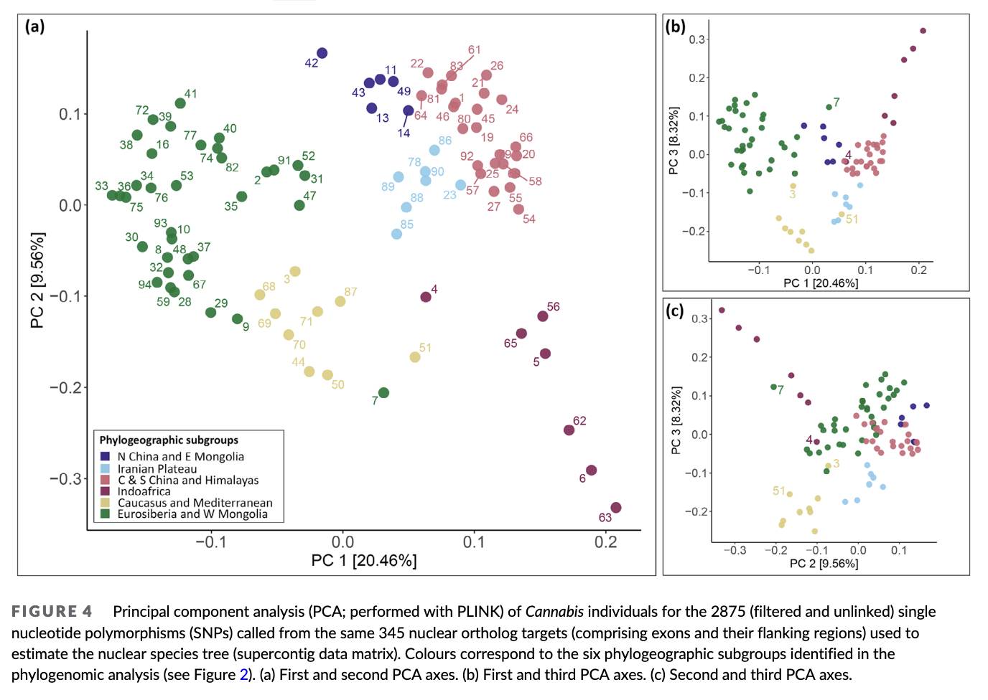

Slide 6
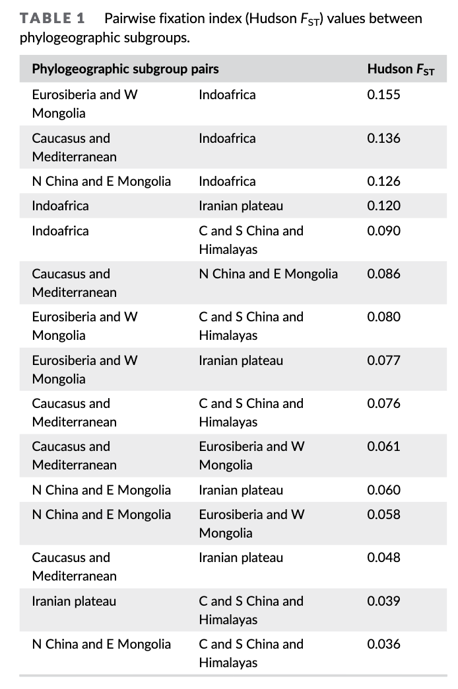

Slide 7
Student questions
They sent their DNA extraction samples to be sequenced by a private company. What are the risks and benefits of doing your own sequence work vs paying it for a company to do it for you?
How important was human dispersal in the history?
Potential issues with herbarium specimens?
What’s a paralog? SNP? Exon? Flanking regions? Linkage disequilibrium? F_{ST}?
68,212 SNPs -> 2,875 after filtering. Good idea? Bad?
In addition, the STRUCTURE model assumes that markers are neutral, which--if they are located within genes--one can reasonably expect that they generally are not. The paper gave some phenomenal background information, but I'm not particularly comfortable with how they analyzed and interpreted their data.
How might degraded herbarium samples affect results?
RAXML-NG vs RAXML
How would you analyze what changed with domestication?
Why no time calibration?

